Slide 1
DCC Micro Project
Abdurrahman Qureshi 210451
Saad Ansari 210453
Arya More 210460
Adnan Kazi 210463

Slide 2

Topic

Slide 3
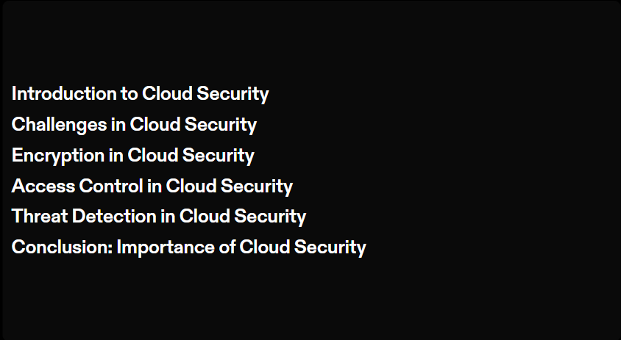

Slide 4


Slide 5
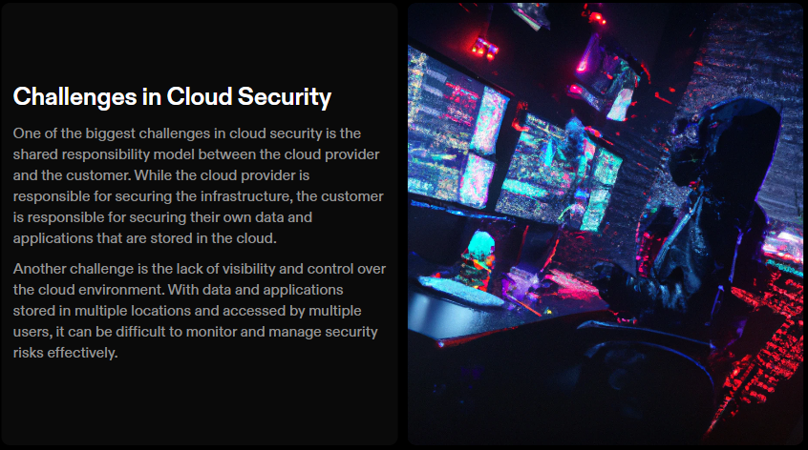

Slide 6
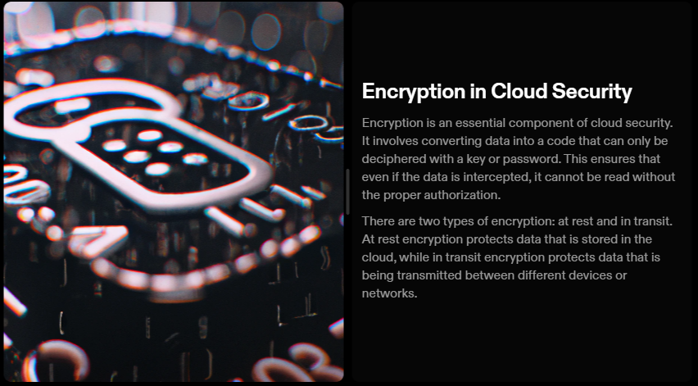

Slide 7
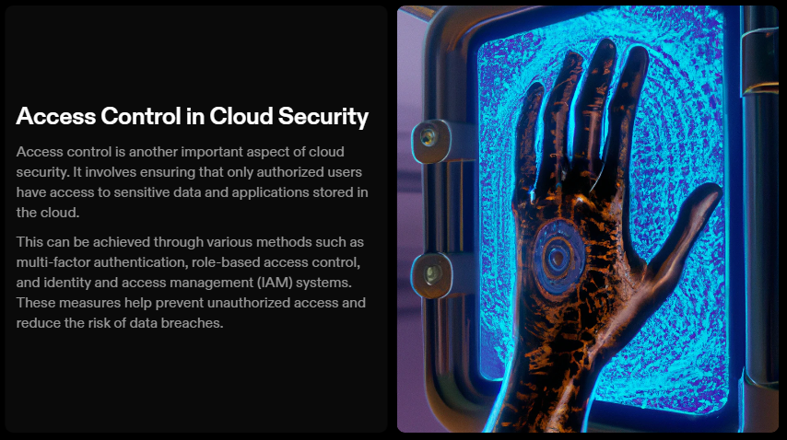

Slide 8


Slide 9
